Slide 1
Implementation Diagram
Software Design and Architecture (SE:2002)

Slide 2




Homogenization of the system
 In parallel design process, several stimuli with the same purpose or meaning are defined by several designers. These stimuli should be consolidated to obtain as few stimuli as possible. It is called homogenization.
 Homogenize - to change (something) so that its parts are the same or similar.

Slide 3

Why is homogenization required
If different teams are working on different scenarios, a class may be called by different names.
These name conflicts must be resolved.
Homogenization is an ongoing process.

Slide 4

Elements of Homogenization
COMBINING CLASSES
SPLITTING CLASSES
ELIMINATING CLASSES
SCENARIO WALK THROUGH
EVENT TRACING
DOCUMENTATION REVIEW

Slide 5

Homogenization
COMBINING CLASSES
examine each class with its definition.
Examine attributes and functions of the classes.
Look for the use of synonyms.
Once you determine that the 2 classes are doing the same thing, choose the name that is closest to the language used by the customer.

Slide 6

Homogenization
SPLITTING CLASSES
Classes should be examined if they are following the golden rule of OO, that is A class should do one thing and it should do really well.
Example :
A StudentInformation class contains:
Info about student Actor
And info about the courses that student has successfully completed.
Resolve into 2 classes: StudentInfo and Transcript.

Slide 7

Homogenization
ELIMINATING CLASSES
When?
A class does not have any structure or behavior
The class does not participate in any use cases
Guideline: Look for the control classes in particular. Lack of the sequencing responsibility may lead to the deletion of the class.
Example:
A control class is only a pass through or a forwarder. I.e., it received information from boundary class and only passes it to the entity class without the need of sequencing logic.

Slide 8

Homogenization
CONSISTENCY CHECKING
Why ?
Because static view of the system and dynamic view of the system and interaction view of the system are under development in parallel.
Consistency checking is necessary to check if all the 3 views of the system has the same assumptions / decisions and terminology used.
Consistency Checking is done by forming a small team.
Team members 5-6.
Analyst, Designer, Customer / Customer Rep., Domain experts.

Slide 9

Homogenization
SCENARIO WALK THROUGH
A simple method of consistency checking is walk through of high risk scenario as represented by sequence / collaboration diagrams.
Specially check the reflexive relationships because they are likely to miss during analysis.
Reflexive relationships are needed when multiple objects of the same class interacts during a single scenario.
Finally verify that each object in sequence / collaboration diagram belongs to a class on the class diagram.

Slide 10

Homogenization
EVENT TRACING
For every message on the sequence / collaboration diagrams:
Verify that an operation is responsible to send the message in the sending class
Verify that an operation is responsible to receive the
message in the receiving class and handles it properly.
Verify that there exists some kind of association between sending and receiving classes on the class diagram.
Verify each message in the state transition diagram.

Slide 11

Homogenization
DOCUMENTATION REVIEW
Each class should be documented.
Verify that each method and attribute is defined properly.
Finally check for the establishment of documentation standards, format specifications, and content rules.
Make sure that all the standards established are followed.

Slide 12

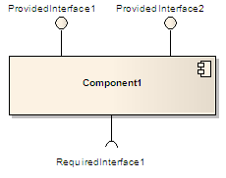

Component(UML)
 A component in the Unified Modeling
Language "represents a modular part of a system, that encapsulates its content and whose manifestation is replaceable within its environment. A component defines its behavior in terms of provided and
required interfaces".^{[1]}
Manifestation : an event, action, or object that clearly shows or embodies something abstract or theoretical.

Slide 13

Component (UML)
A component may be replaced by another if and only if their provided and required interfaces are identical.
This idea is the underpinning for the plug-and- play capability of component-based systems and promotes software reuse.
UML places no restriction on the granularity of a component. Thus, a component may be as small as a figures-to-words converter, or as large as an
entire document management system.
Such assemblies are illustrated by means of component diagrams.

Slide 15

Implementation Diagrams
Both are structural diagrams
Component Diagrams:
set of components and their relationships
Illustrate static implementation view
Component maps to one or more classes, interfaces, or
collaborations
Deployment Diagrams:
Set of nodes and their relationships
Illustrate static deployment view of architecture
Node typically encloses one or more components

Slide 16

Package
General purpose mechanism for organizing elements into groups
Can group classes or components.
Package Name

Slide 17


Component Diagram
Classes
Interfaces
Dependency, generalization, association, and realization relationships
Example.java
Special kind of class diagram focusing on system’s components.

Slide 18

Interfaces
Definition:
Collection of operation signatures and/or attribute defns
Defines a cohesive set of behaviors
Realized by:
Implemented by classes and components
Implement operations/attributes defined by interface
Relationships:
A class can implement 0ne or more interfaces
An interface can be implemented by 1 or more classes
Notation:
Lollipop
Dashed arrow

Slide 19

UML Component Diagrams
Component diagram shows components, provided and required interfaces, ports, and relationships between them. This type of diagrams is used
in Component-Based Development (CBD) to describe systems with Service-Oriented Architecture (SOA).
Component-based development is based on assumptions that previously constructed components could be reused and that components could be replaced by some other "equivalent" or "conformant" components, if needed.

Slide 20

UML Component Diagrams
Component are intended to be capable of being deployed and re-deployed independently, for instance to update an existing system.
Components in UML could represent
logical components (e.g., business components, process components), and
physical components (e.g., CORBA components, EJB components, ATL, COM+ and .NET components, WSDL (Web Service Definition Language) components, etc.),

Slide 21

Online Shopping - Components
Summary: The diagram shows "white-box" view of the internal structure of three related subsystems: WebStore, Warehouses, and Accounting.
WebStore subsystem contains three components related to online shopping - Search Engine, Shopping Cart, and Authentication.
Accounting subsystem provides two
interfaces: Manage Orders and Manage Customers.
Warehouses subsystem provides two interfaces: Search Inventory and Manage Inventory used by other subsystems.

Slide 22
Online Shopping - Components
WebStore subsystem contains three components related to online shopping - Search Engine, Shopping Cart,
and Authentication.
Search Engine component allows to search or browse items by exposing provided interface Product Search and
uses required interface Search Inventory provided by Inventory component.
Shopping Cart component uses Manage
Orders interface provided by Orders component during checkout.
Authentication component allows customers to create account, login, or logout and binds customer to some account.
Accounting subsystem provides two interfaces - Manage Orders and Manage Customers.

Slide 23

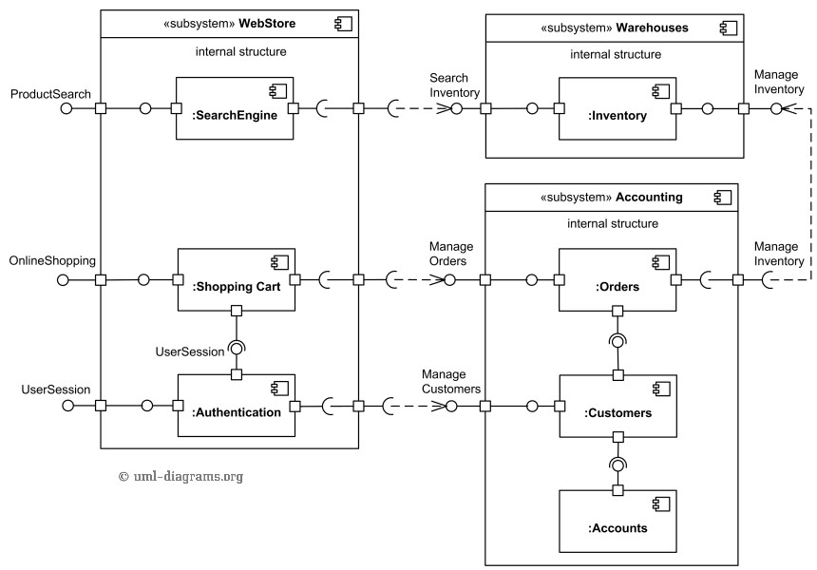
Ex1: Component Diagram

Slide 24

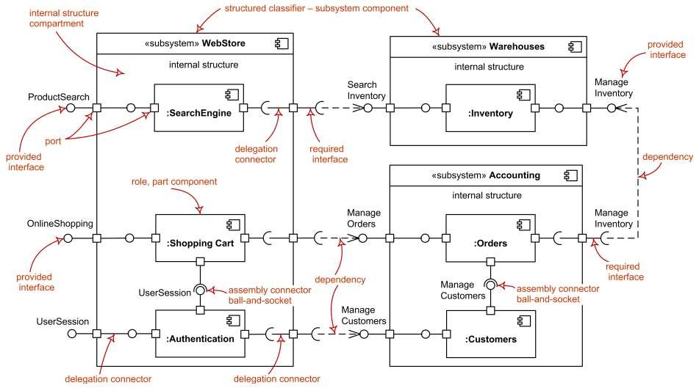
Ex1: UML Component Diagram

Slide 25

Online ordering / shipping
Online Ordering and Shipping applications uses Apache Struts framework forMVC. There isa Customer componentwhich provides XML (data) and ICustomer interfaces. There isan Orders componentwhich provides XML (data) and IOrderinterfaces.
Ordering Appuses IOrder & ICustomer interfaces toplaceorders. Shipping Apprequires XML data from Customer component & uses IOrderto link respectiveorders forshipping.
Security infrastrure provides IAccesControl & IEncryption interfaces. IAccesControl isused by Ordering, Shipping, Customers and Orders.
Persistence infrastructure hasa dependency on CorporateDB componentvia JDBC. Persistence infrastructure provides IPersistence used by Customers and Ordersto providestorage persistency for customerorders.

Slide 26

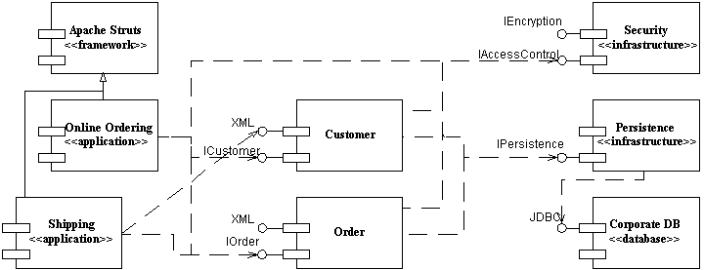
Ex3: Component Diagram

Slide 27


Slide 28

Deployment Diagram
Shows the configuration of:
run time processing nodes and
the components that live on them
Graphically: collection of vertices and arcs

Slide 29

Contents
Deployment diagrams contain:
Nodes
Dependency and association relationships
may also contain components, each of which must live on some node.

Slide 30












A Deployment Diagram
Internet
node Modem bank
<<processor>>
Caching server
<<processor>>
Caching server
connection
<<network>> local network
<<processor>> primary server
<<processor>>
<<processor>>
<<processor>>
server
server
server

Slide 31

Modeling Client-Server Architecture
Identify nodes that represent system’s client and server processors
Highlight those devices that are essential to the behavior
 E.g.: special devices (credit card readers, badge readers, special display devices)
Use stereotyping to visually distinguish

Slide 32

















Client-Server System
Human resource system
2 pkgs: client, server
Client: 2 nodes
console and kiosk
stereotyped, distinguishable
Server: 2 nodes
caching server and server
Multiplicities are used
client
console
kiosk
server
4..*
<<processor>> server
Deploys
dbadmin.exe tktmstr.exe logexc.exe
2..*
<<processor>>
Caching server
Deploys
Http.exe rting.exe

Slide 33

Guidelines for Deployment Diagrams
General [Ambler 2002-2005]
Indicate Software Components on Project-Specific
Diagrams
Focus on Nodes and Communication Associations on Enterprise-Level Diagrams
Nodes and Components
Name Nodes With Descriptive Terms
Model Only Vital Software Components
Apply Consistent Stereotypes to Components
Apply Visual Stereotypes to Nodes
Dependencies and Communication Associations
Indicate Communication Protocols Via Stereotypes
Model Only Critical Dependencies Between Components

Slide 34
Assuming Chawla Super store consists one main database that holds information about products, sales, purchases, inventory and customers. The Chawla Store Point of Sales (POS) counter is where the customer arrives with the items to be purchased. The cashier records each item, price and adds the item information to the running sales transaction. The description and price of the current item are displayed on screen.
On completion of the item entry the cashier informs about the total to customer. The customer can pay via card or cash. After the payment is made, the system automatically generates a receipt through a printer and updates the inventory in the database. The entire system is connected through Local Area Network (LAN) and the card machines are connected through WIFI that process transactions on behalf of the banks. Draw deployment diagram for Chawla super store sales system.

